Slide 1
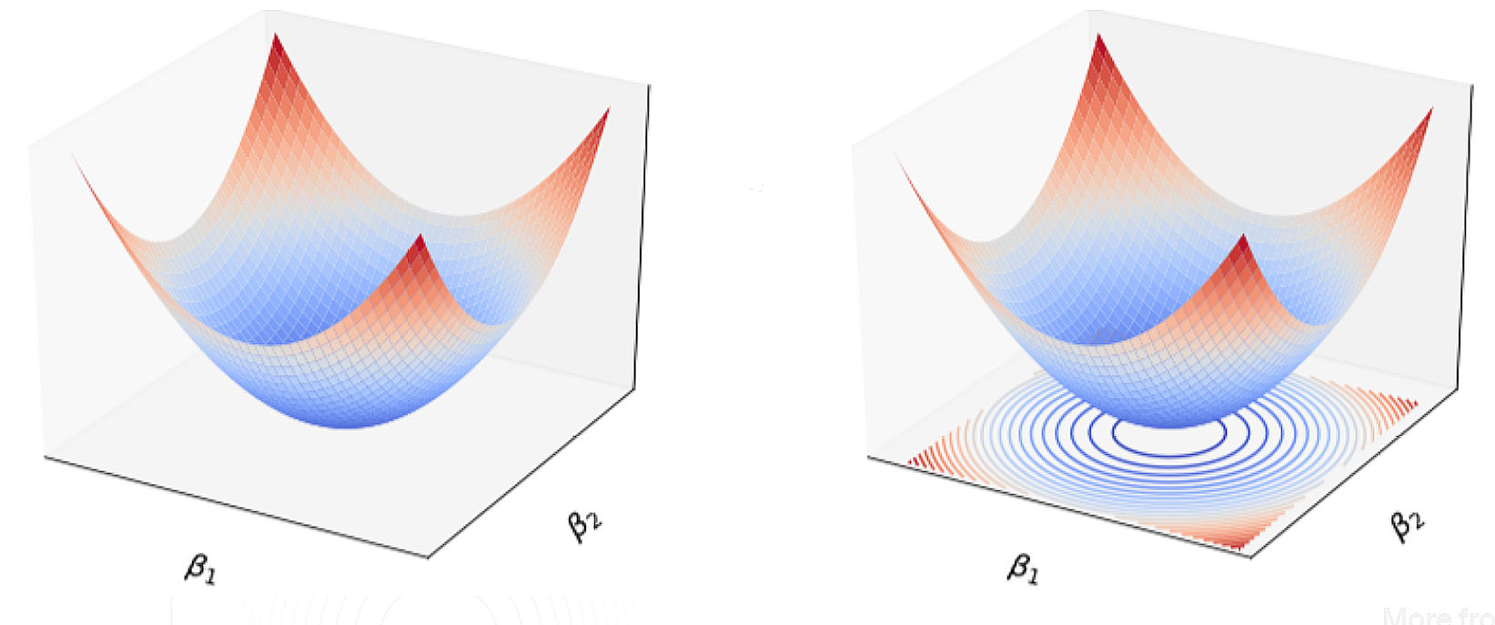



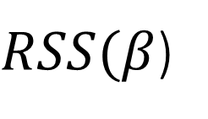

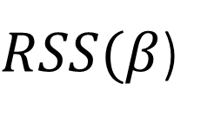
$RSS(β$)
$RSS(β$)
$$β_{2}$$
$$β_{2}$$
$$β_{1}$$
$$β_{1}$$
https://medium.com/@IwriteDSblog/the-regularized-models-9ed187c0bfc9

